Slide 1

Data Bricks - Cigna
Employee Information.
By Bharathwaj K S

Slide 2

Project Description
This project focuses on managing and transforming employee-related data for analytical and reporting purposes within the Databricks Lakehouse platform.
We are ingesting raw employee information from multiple CSV sources into structured delta tables.
The pipeline is built to handle large datasets across multiple domains like Employee, Payroll, Projects, Trainings, and Departments
The goal is to automate the data flow through raw, cleaned, conformed, and publication zones with a robust and scalable design.
Ultimately, this project delivers meaningful insights such as total training hours per employee, department alignment, payroll summary, and current project allocation.

Slide 3
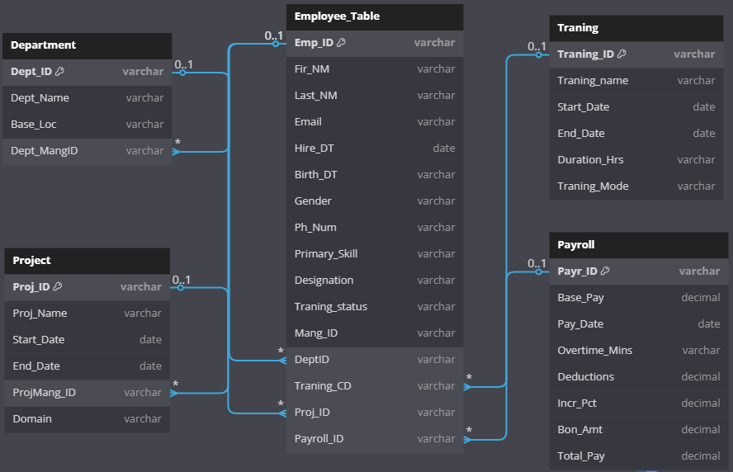
Data Model
Five Core Entities
Employee: personal info, contact, skills, FK links
Department: department name, location, manager
Project: project metadata, domain, manager
Training: courses attended, dates, duration
Payroll: pay details, overtime, bonuses

Slide 4


Business Justification
Enhanced Workforce Analysis
Specific Query Resolution
Reduced Manual Effort
For instance, a delivery manager can now answer questions like, “Which employee completed a specific training and also worked on Project X?” — without needing to manually combine datasets or rely on outdated records.
It reduces the manual effort for reporting by transforming semi-structured data into governed, historical views.
This project enables business users and HR managers to analyze detailed workforce information in a clean and ready-to-consume format.
Audit Readiness & Transparency
Scalable Data Management
Also ensures audit readiness and transparency across employee lifecycle events like pay raises, reassignments, or certifications.
Since data is managed via Delta tables on Databricks, it supports ACID transactions, scalable queries, and time-travel to track historical values efficiently.

Slide 5




Data Flow (Rawz → Work → Confz → Pubz)
Rawz Zone
Work Zone
In this zone, raw data undergoes cleaning, standardization, and deduplication using deterministic checksum logic. It handles validations like proper date formats, padded IDs, and email/phone cleaning.
This is the initial landing zone for raw CSV files ingested through a custom Python utility. All files are appended with no transformation and an audit log is maintained.
1
2
Pubz Zone
Confz Zone
The final reporting layer where consolidated results are published, including key metrics like total training hours, payroll details, and project participation—all in one unified view.
4
This layer applies Slowly Changing Dimension Type 2 (SCD2) logic. We manage full data history and track changes across attributes by marking old rows inactive (curr_ind = 'N') and new rows active (curr_ind = 'Y').
3

Slide 6
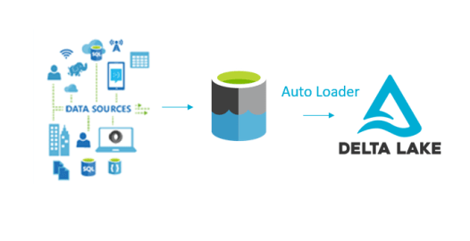
Key Concepts Explained
Surrogate Key
Audit Table
Automatically generated unique identifiers using uuid() in the Work zone tables (e.g., Emp_Key, etc.). These act as immutable primary keys for consistent SCD2 tracking.
A centralized delta table in Rawz zone that tracks each ingested file. It logs the filename, load status, number of rows inserted, and the full path for traceability.
Data Bricks
Delta Tables
Load Key
Every load generates a unique load_key using a custom function. Format used is: LCKYYYYMMDDHHMMSSDDDD (e.g., LCK202506031015398377). This key helps trace which rows came from which file and timestamp.

Slide 7
Data Preparation / Cleaning (Work Zone)
All leading/trailing spaces are trimmed across string columns like names and designations.
Middle spaces in names or descriptions are replaced with a single underscore for uniformity.
All ID columns are padded to 8 digits using LPAD(...) so they're consistent across joins.
Phone numbers are stripped of symbols like +, (), or - to keep only digits.
Date fields are converted to a standard format YYYY-MM-DD regardless of input separator (/, .).
Invalid email addresses (those not ending in proper .com, .net, .org) are filtered out.
Checksum (SHA2 256-bit) is generated using cleaned columns to identify duplicates.

Slide 8
Slowly Changing Dimension (SCD2)
SCD Type 2 Application
1
SCD Type 2 is applied in Confz_zone to track historical changes.
Handling Record Changes
2
If an existing employee record changes (say, training status or designation), we don’t overwrite—it instead marks the old row as inactive.
Checksum Logic
3
If checksum differs → update curr_ind = 'N' and end_date = today
Full History & Current State
Insert new row → with curr_ind = 'Y', start_date = today, end_date = 9999-12-31
4
This gives full history of changes while allowing easy “current state” filtering.

Slide 9
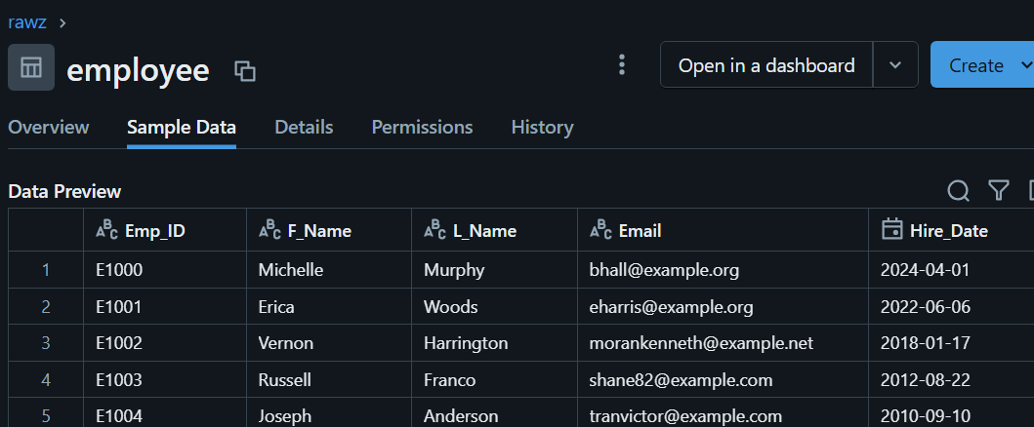
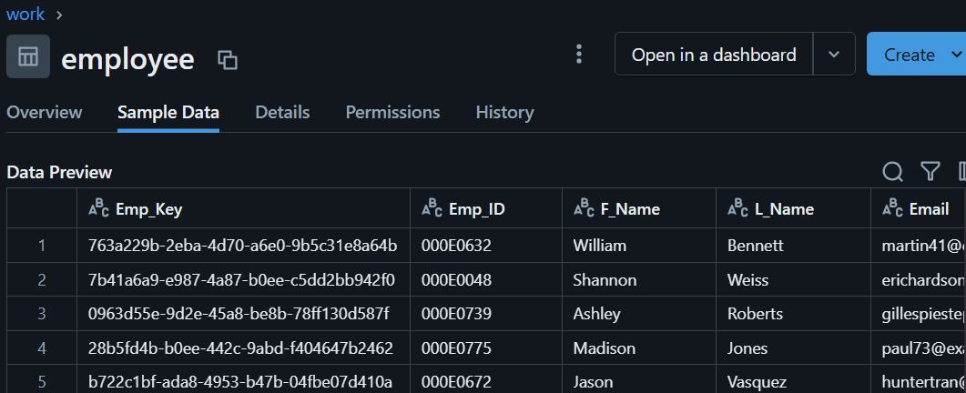
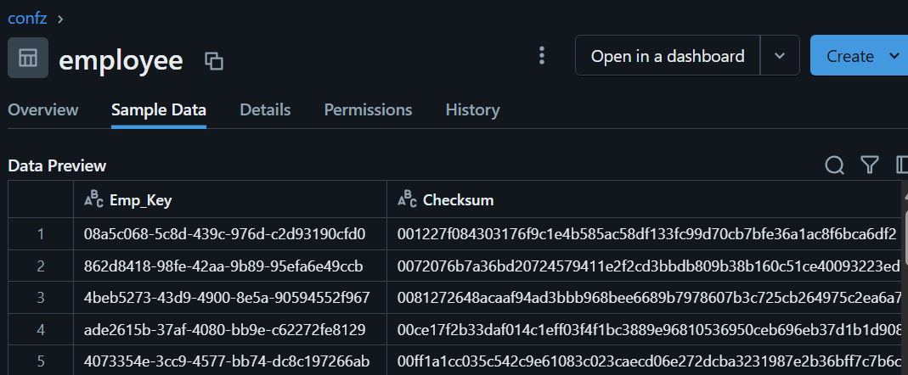
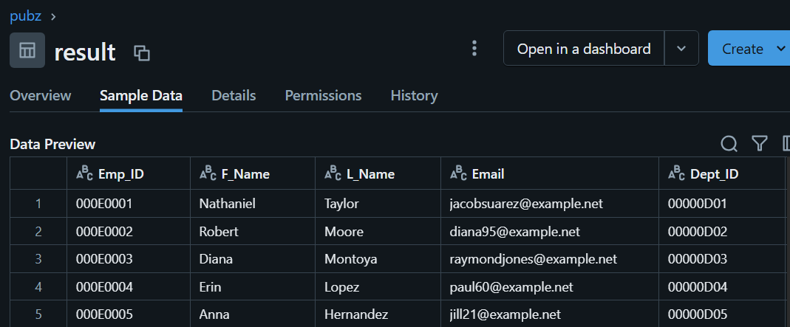
Sample Data Screenshots
Rawz.Employee Full original columns from CSV with load key | Work.Employee Cleaned & validated columns + checksum + surrogate key
Confz.Employee SCD2 fields added current indicator | Pubz.Result Final table with joined tables with total training hours

Slide 10
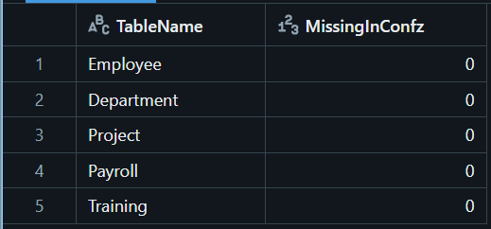
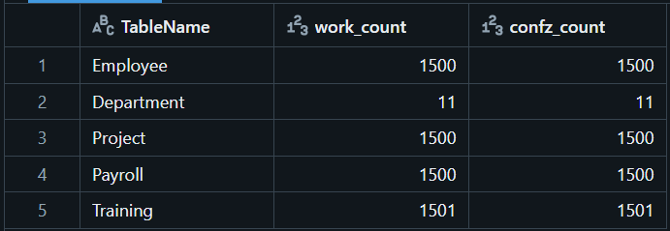
Testing Outputs
A → B Testing
Row Count Testing
We validated that rows from Work zone are correctly loaded into Confz zone using checksum comparison.
Query confirms all checksums from Work exist in Confz (LEFT ANTI JOIN returns zero).
Row counts of Work zone vs Confz current data are compared.
If counts mismatch, then it indicates a transformation or SCD2 logic gap.

Slide 11

Workflow and Job Orchestration
Step 1: Ingest Raw CSV
Step 3: Confz Merge
Ingest raw CSV and audit log update
Confz merge with SCD2 tracking
1
2
3
4
Step 2: Work Zone Cleaning
Step 4: Final Reporting Layer
Work zone cleaning and deduplication
Final reporting layer (Pubz zone)
Jobs were built using Databricks Workflows with clear
dependencies.
Each stage is logged and can be time-traveled using
Delta Lake features

Slide 12
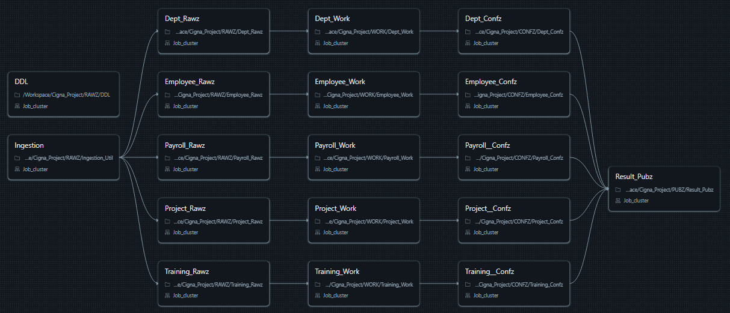
Job Flow
DDL
Data Ingestion
This Job Contains All the DDL commands of the table
In the job ingestion job, the data is ingested from DBFS to rawz layer.
Workflow layers
Workflow layers
The data is their transformed from rawz to work to confz layers.
The data is their transformed from rawz to work to confz layers.

Slide 13
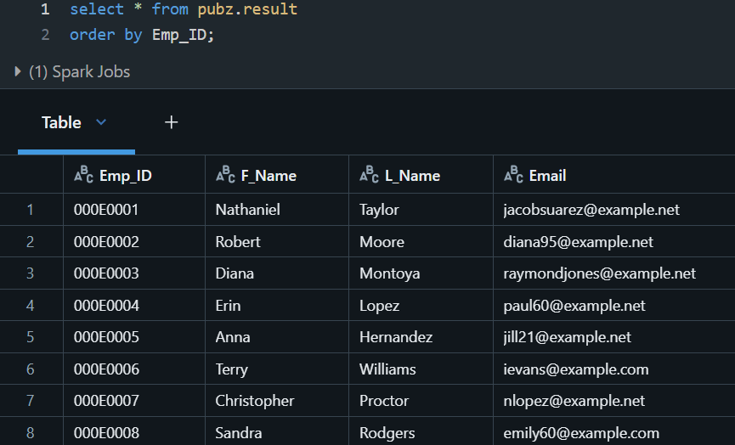

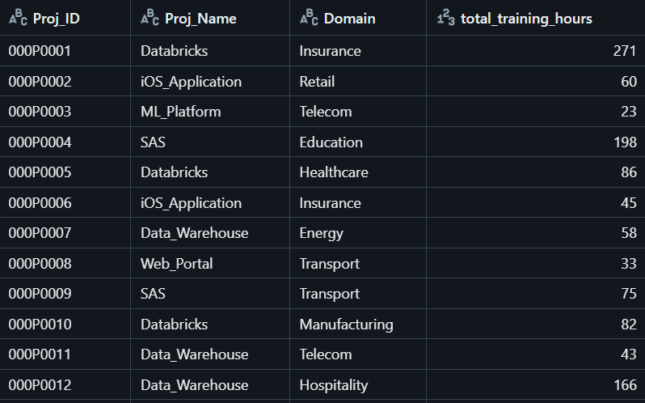
Result Output in Pubz Zone
Employee Contact & Department
Assigned Project & Domain
Includes employee contact and department
Assigned project and domain
Payroll
Total Training Hours
Payroll : base pay, bonus, total pay
Total training hours summed across all training attended
Final table pubz.result provides a one-glance view for decision makers.
This is the key outcome of the entire project—ready to be consumed for business insight and much more.

Slide 14

Thank You
I appreciate your time and engagement today. I look forward joining the in future.

